Slide 1
Downloading R and Rstudio
Step by step (Mac)

Slide 2
1. To install R, go to cran.r-project.org
Open your web browser and go to the R Project website: https://cran.r-project.org/.

Slide 3
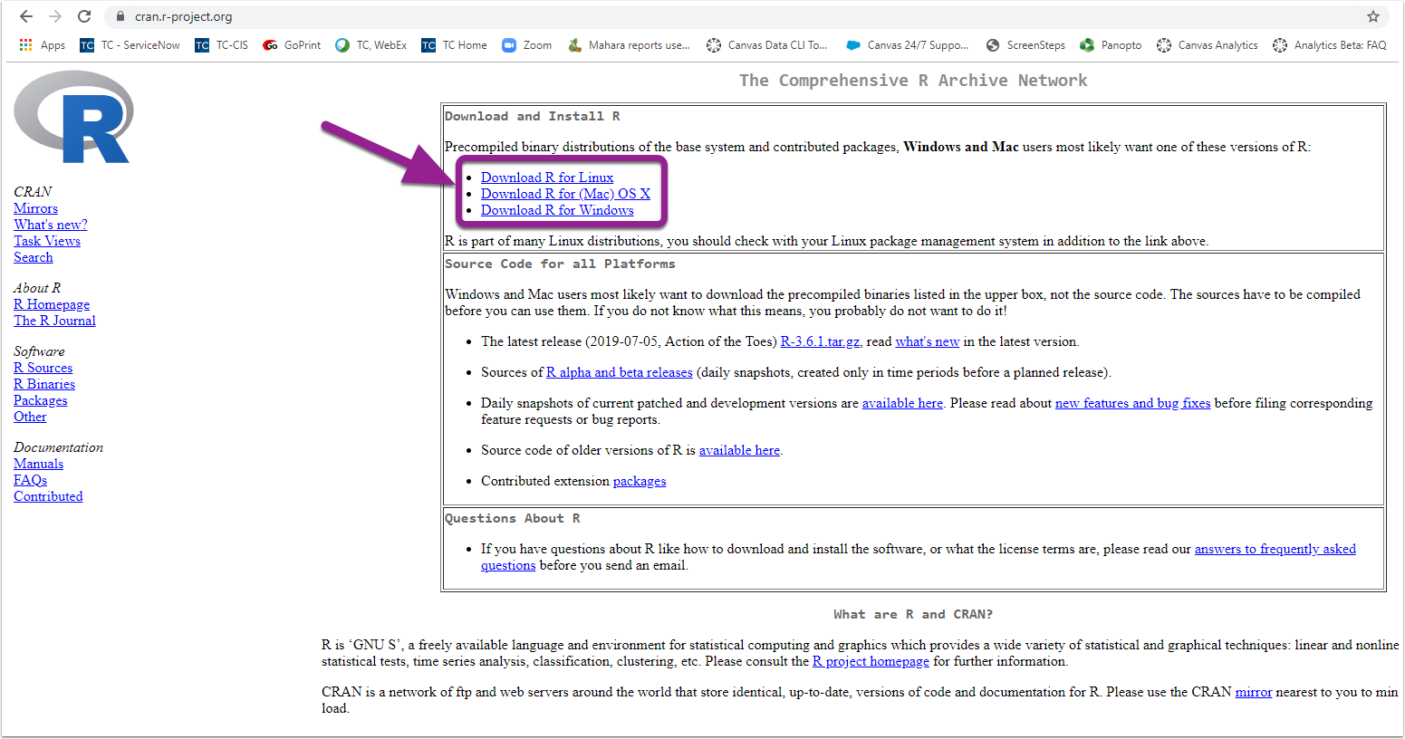
2. Depending on your operating system, click Download R for your operating system.

Slide 4
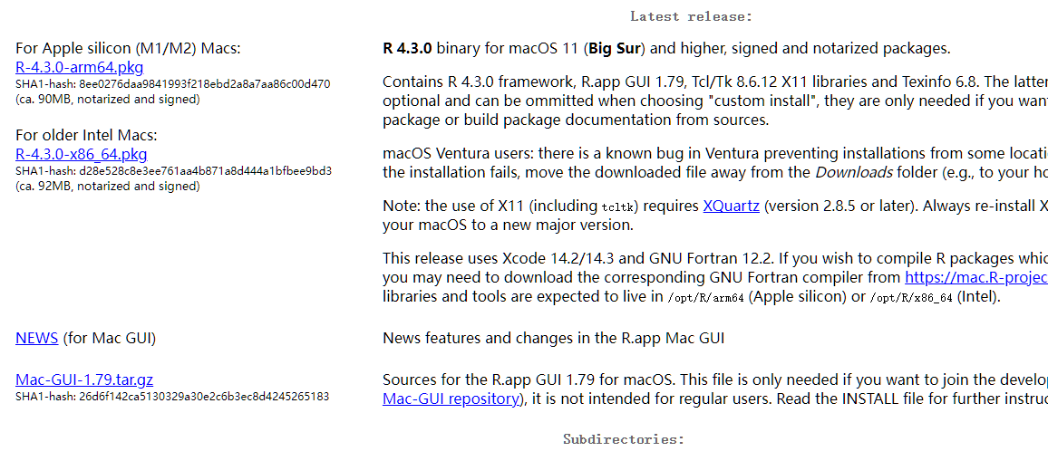
3. Click on R-4.3.0.pkg according to your system to install R.
or

Slide 5
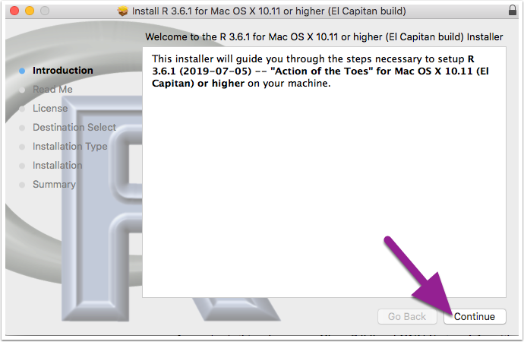
4. Once the file download is complete, click to open the installer. Click Continue and proceed through the installer.

Slide 6
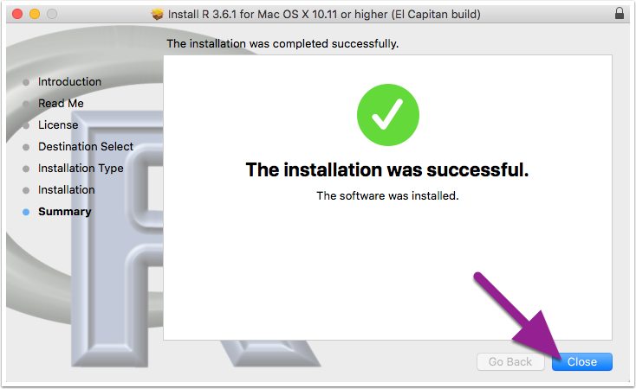
5. Once the R installer has finished, click Close.

Slide 7
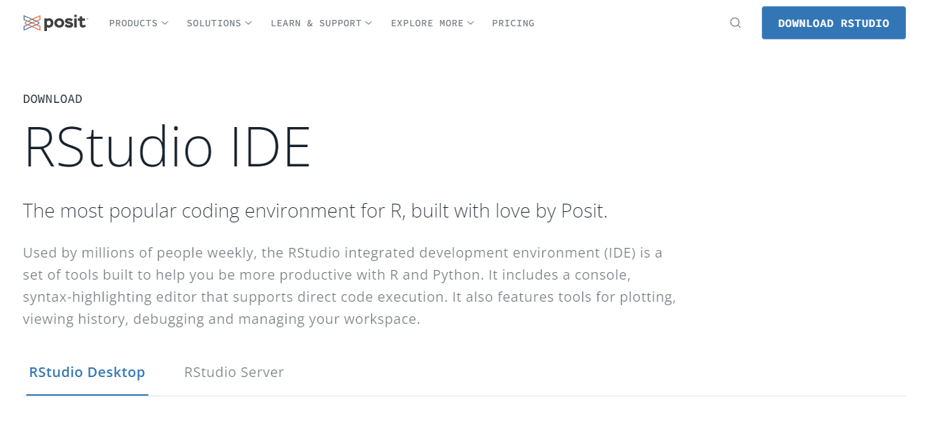
6. Next, download RStudio. Go to www.rstudio.com, Click Download RStudio.

Slide 8
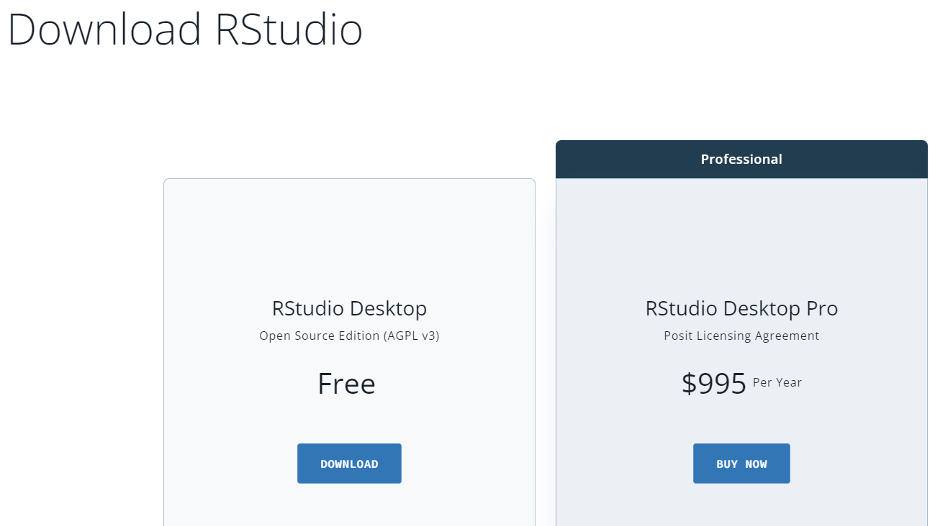
7. Click Download under RStudio Desktop- Open Source Edition

Slide 9
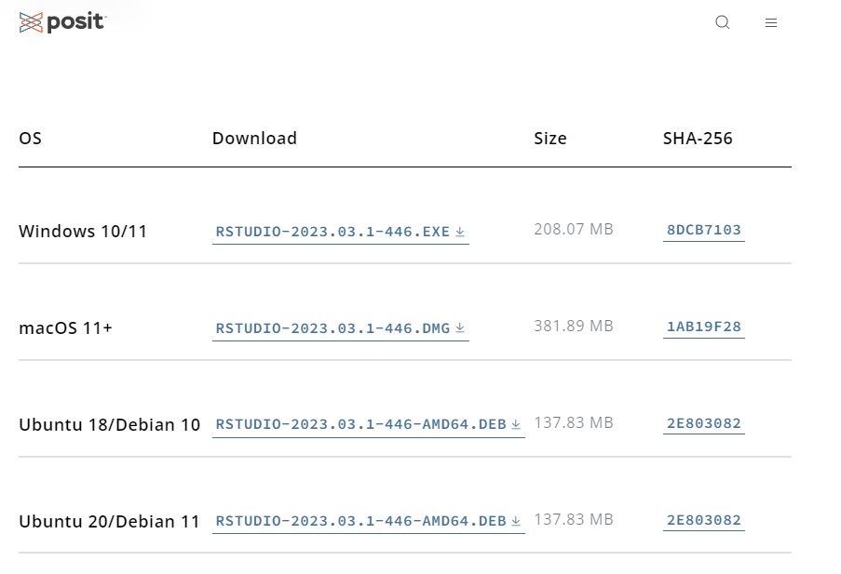
8. Click on the operating system that you are working with.

Slide 10
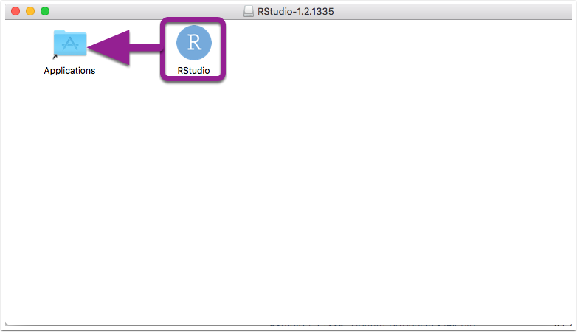
10. Once the file download is complete, click to open the installer. Drag RStudio into your applications folder.

Slide 11
11. Congratulations! You have now installed R and RStudio.

